Slide 1
Welcome to Year 11 Human Biology
Mr Simeoni

Slide 2
Rules
When I am explaining or talking, please listen.
Follow my instructions when asked.
Hands up to ask questions.

Slide 3
No Food or Drink
Water is allowed. Only water.

Slide 4
Phones off and away

Slide 5
COVID
Hands Sanitized as you enter class.
Masks on at all times, unless you answering a questions.
Students with pre-existing medical reasons are exempt.
Be sensible.

Slide 6
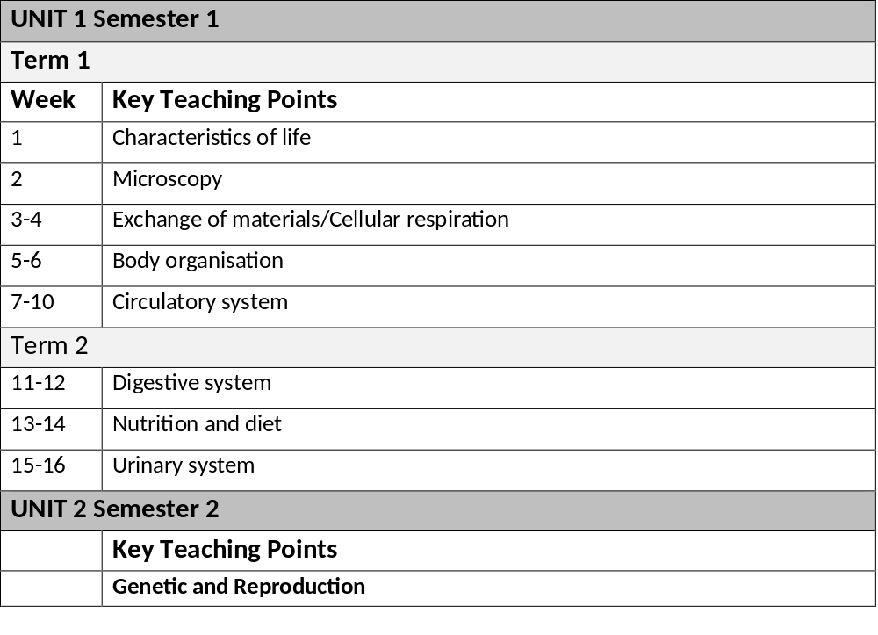
Program for the year.

Slide 7
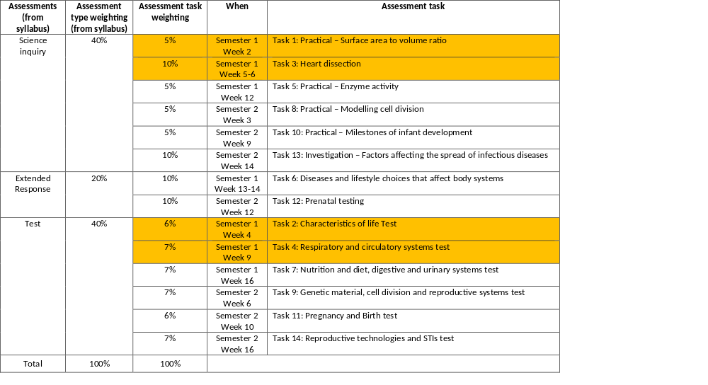
Assessments for the year.

Slide 8
Class Activity
I have a small tin on the table. Without touching the tin with their hands or arms the class must identify if there is anything in the tin or not.
Rule 1: They all must agree on their plan of action before they are doing anything.
Rule 2: Must not damage the tin.

Slide 9
What is science?
More than just guessing.
Observe
Hypothesize
Test, Collect information
Conclude
Revisit hypothesis

Slide 10
Lesson Objective
Recognise the processes that define what it is to be alive.

Slide 11
Life Processes
How do you know if someone is alive or dead?
All living things carry out life processes in order to keep the cells metabolizing and supplying energy for body activities.

Slide 12
Activity: Am I Alive?
Purpose
To collect evidence that indicates the operation of life processes in the human body.
To recognise life processes in the living body and link them to specific body systems and functions.

Slide 13
Materials.
drinking straw
50 mL lime water
100 mL beaker
calipers
cotton buds
reflex hammer
Internet
textbooks

Slide 14
What are the seven life processes?
Respiration
Nutrition
Excretion
Movement
Growth
Reproduction
Sensitivity

Slide 15
Are you respiring?
Blow gently through a straw into a solution of limewater.
Note the colour change.
1. What causes the limewater to change colour?
2. What evidence does this test give to indicate that you are respiring?

Slide 16
Have you ingested today?
1. What have you eaten today?
2. What evidence do you have that the food has been digested (changed the food chemically) and absorbed?
3 . Why is there a need to digest food?

Slide 17
Are you excreting?
1. Can you recall the colour of your urine?
2. What does the colour signify about the state of your body?

Slide 18
Are you moving?
Sit on a chair with your legs crossed so that the foot of the crossed over leg is off the floor.
Try to sit as still as possible for 2 minutes.
1. What happened to the cross-over leg? What causes this movement?
2. What other movements occur without you thinking about them?

Slide 19
Are you growing?
Nails are made of dead cells. How can the accumulation of dead cells (your nails) be used to indicate the life process of 'growth'?
What is the evidence to indicate that nails are made of non-living material?
Are there any other ways in which you can identify growth in the human body?

Slide 20
Reproduction
How do we know we are reproducing?

Slide 21
Response to stimuli?
a. Close your eyes and have some one gently tough your eyes lashes with a cotton bud.
b. Sit on a table with your legs dangling over the edge. Gently tap the tendon beneath your kneecap.
1. Can you stop the reactions caused by the cotton bud or the tap on your tendon?
2. Did you have to think about the reaction to either stimulus?

Slide 22
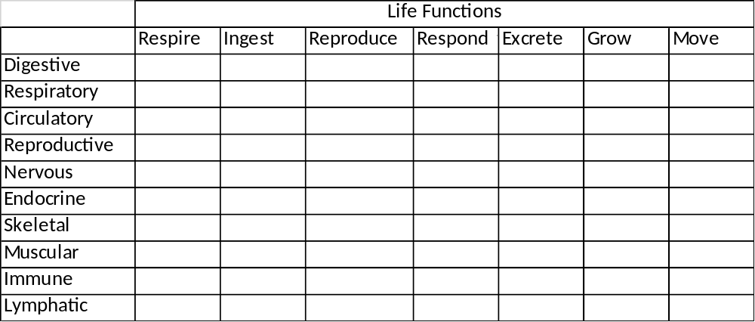
Linking body system to life processes.
Copy Table.
Place a tick ( in the column if you think the system listed is involved in any of the life processes.

Slide 23
Linking body system to life processes.
Check for understanding
Which of the body systems can you live without?
Explain which evidence of life processes are not always present in living humans.
How is all this information evidence of you being alive?
How can you tell if a person is unconscious or dead?

Slide 24
Next Lesson
Cell Theory

